Slide 1
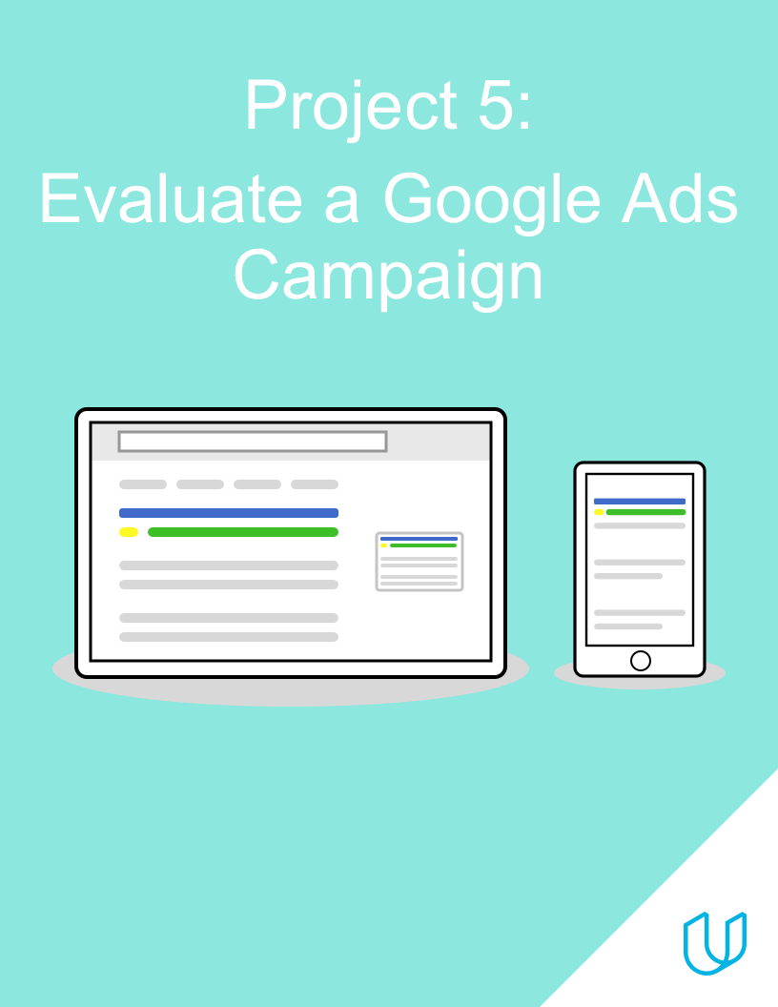
BY: PEACE NGOZI AGHEDO

Slide 2
Campaign Approach
Description and Marketing Objective

Slide 3
1. Campaign Approach
2. Marketing Objective
Udacity has launched a campaign to advertise for the Digital Marketing Nanodegree Program
The campaign is divided into two ad groups, one targeting customers in the Awareness stage and one targeting customers in the Interest stage
Each ad group uses responsive search ads, with multiple options for the ad headline and description
When users click on an ad, they are taken to the overview page for the Digital Marketing Nanodegree Program, where they can click a button to download the program syllabus. This conversion has an estimated value of $5.
The campaign’s marketing objective is to gather at least 200 conversions (syllabus downloads), with a conversion rate of at least 10%

Slide 4
Ad Groups
Ads and Keywords

Slide 5
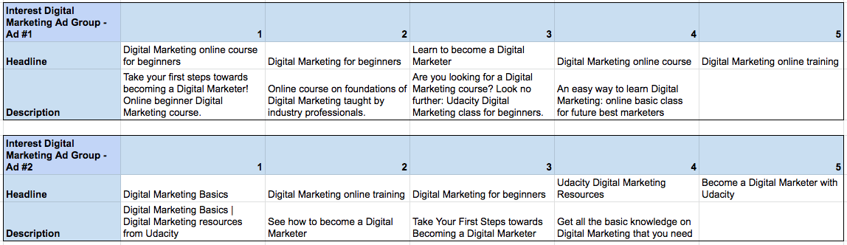
Ad Group #1: Ads
Data is also available in this spreadsheet

Slide 6
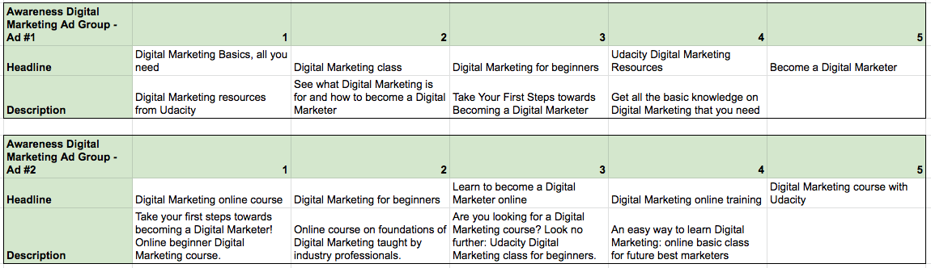
Ad Group #2: Ads
Data is also available in this spreadsheet

Slide 7
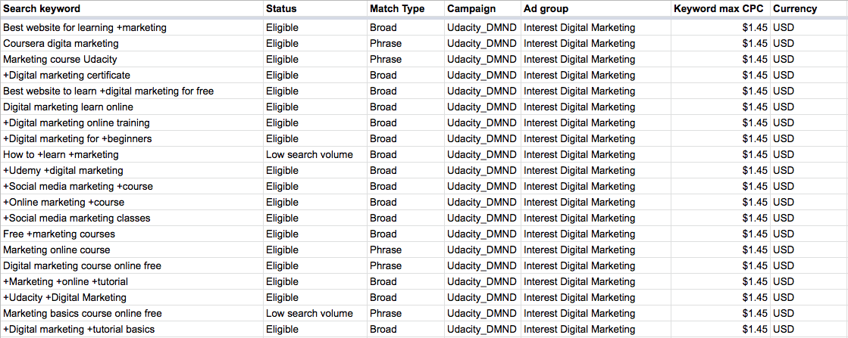
Ad Group #1: Keywords
Data is also available in this spreadsheet

Slide 8
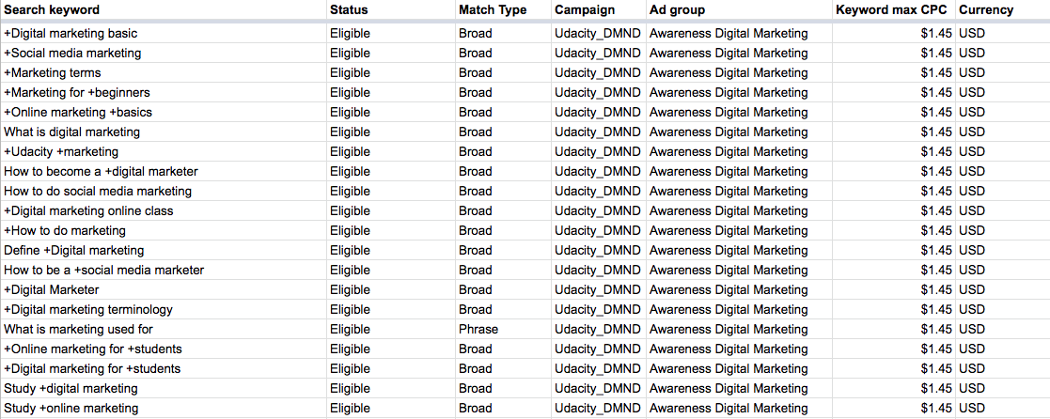
Ad Group #2: Keywords
Data is also available in this spreadsheet

Slide 9
Campaign Evaluation
Results, Analysis and Recommendations

Slide 10
Key Results (Campaign)
Expand the table below to identify and fill in any campaign-level KPIs/metrics you feel will be relevant to your evaluation of the campaign’s performance
Ad Group | Cost | Clicks | Impressions | Conversions | CPC | CTR | C/C | CR
Udacity DMND Campaign | $1,314.00 | 2391 | 111256 | 221 | $0.55 | 2.15% | $5.95 | 9.24%
Campaign data is also available in this spreadsheet
To add columns to your table, right-click where you want to add the column and select either “insert column left” or “insert column right”

Slide 11
Key Results (Ad Groups)
Expand the table below to identify and fill in any ad group-level KPIs/metrics you feel will be relevant to your evaluation of the campaign’s performance
Ad Group | Cost | Clicks | Impressions | Conversions | CPC | CTR | C/C | CR
Ad Group 1: Interest Digital Marketing | $819.05 | 1553 | 72497 | 132 | $0.53 | 2.14% | $6.20 | 8.50%
Ad Group 2: Awareness Digital Marketing | $494.95 | 838 | 38759 | 89 | $0.59 | 2.16% | $5.56 | 10.62%
Total | $1,314.00 | 2391 | 111256 | 221 | $0.55 | 2.15% | $5.95 | 9.24%

Slide 12
Key Results (Ads)
Expand the table below to identify and fill in any ad-level KPIs/metrics you feel will be relevant to your evaluation of the campaign’s performance
Ad | Cost | Clicks | Impressions | Conversions | CPC | CTR | C/C | CR
Ad Group 1, Ad 1 | $458.25 | 991 | 40163 | 97 | $0.46 | 2.47% | $4.72 | 9.79%
Ad Group 1, Ad 2 | $360.80 | 562 | 32334 | 36 | $0.64 | 1.74% | $10.02 | 6.41%
Ad Group 2, Ad 1 | $335.60 | 619 | 28827 | 72 | $0.54 | 2.15% | $4.66 | 11.63%
Ad Group 2, Ad 2 | $159.35 | 219 | 9932 | 16 | $0.73 | 2.20% | $9.96 | 7.31%

Slide 13
Key Results (Keywords)
Search keyword | Status | Match Type | Campaign | Ad group | Keyword max CPC | Currency | Cost | Clicks | Impressions | Conversions | CPC | CTR | C/C | CR
+Online marketing +course | Eligible | Broad | Udacity_DMND | Interest Digital Marketing | $1.45 | USD | $317.10 | 534 | 26639 | 65 | $ 0.59 | 2.00% | $ 4.88 | 12.17%
+Social media marketing +course | Eligible | Broad | Udacity_DMND | Interest Digital Marketing | $1.45 | USD | $36.00 | 66 | 912 | 10 | $ 0.55 | 7.24% | $ 3.60 | 15.15%
+Digital marketing certificate | Eligible | Broad | Udacity_DMND | Interest Digital Marketing | $1.45 | USD | $23.10 | 48 | 894 | 8 | $ 0.48 | 5.37% | $ 3.08 | 15.63%

Slide 14
Campaign Evaluation
Evaluate how successful the campaign was, based on the marketing objective
Feel free to use “bullet points” for your analysis and add as many slides as you need.
Include the following information in your answer (you can also review Lesson 6 in the SEM course for some additional guidance):
The campaign’s return on investment (ROI), including identification of whether the campaign was ROI-positive or ROI-negative
ROI = (total conversion value - total cost)/total cost
Identify and calculate at least three relevant KPIs at the campaign, ad group, ad, and keyword level
Based on your KPI calculations, identify which three keywords performed the best, and explain your reasoning for the ones you selected
Based on your KPI calculations, make an inference about which keywords are subject to higher competition in Google Ads. Explain your reasoning and which KPIs you used to make your hypothesis.
An overview statement of how well or not well the campaign performed relative to its marketing objective, supported with evidence

Slide 15
Campaign Evaluation
ROI = (Total conversion value – Total cost) Total Cost= (221*5 - $1, 1314.00)/$1,1314)= $0.16.
From this calculation, we are able to deduce that the ROI was negative, there was a loss of $0.16.
Relevant KPI for Campaign Level
Cost Per Click (CPC) = Ad cost / number of clicks = $1,314.00/2391 = $0.55
Click Through Rate (CTR)= (Number of clicks / Number of Impressions) x 100% = (2391/111256) x 100% = 2.15%
Cost per Conversion (C/C)= Ad cost / Conversions = $1,314.00/221 = $5.95
Conversion Rate (CR)= (Conversions / Clicks) x 100% = (221/2391) x 100% = 9.24%
Campaign | Cost | Clicks | Impressions | Conversions | CPC | CTR | C/C | CR
Udacity_DMND | $1,314.00 | 2391 | 111256 | 221 | $0.55 | 2.15% | $5.95 | 9.24%

Slide 16
Relevant KPI For Ad group
Campaign | Cost | Clicks | Impressions | Conversions | CPC | CTR | C/C | CR
Ad Group 1: Interest Digital Marketing | $819.05 | 1553 | 72497 | 132 | $0.53 | 2.14% | $6.20 | 8.50%
Ad Group 2: Awareness Digital Marketing | $494.95 | 838 | 38759 | 89 | $0.59 | 2.16% | $5.56 | 10.62%
Total | $1,314.00 | 2391 | 111256 | 221 | $0.55 | 2.15% | $5.95 | 9.24%
Ad group 1 Cost Per Click (CPC) = Ad cost / number of clicks = $819.05/1553 = $0.53 Click Through Rate (CTR)= (Number of clicks / Number of Impressions) x 100% = (1553/72497) x 100% = 2.14% Cost per Conversion (C/C) = Ad cost / Conversions = $819.05/132 = $6.20 Conversion Rate (CR)= (Conversions / Clicks) x 100% = (132/1553) x 100% = 8.50% | Ad group 2 Cost Per Click (CPC) = Ad cost / number of clicks = $494.95/838 = $0.59 Click Through Rate (CTR)= (Number of clicks / Number of Impressions) x 100% = (838/38759) x 100% = 2.16% Cost per Conversion (C/C) = Ad cost / Conversions = $494.95/89 = $5.56 Conversion Rate (CR)= (Conversions / Clicks) x 100% = (89/838) x 100% = 10.62%

Slide 17
Relevant KPI For Ad Level
Campaign | Cost | Clicks | Impressions | Conversions | CPC | CTR | C/C | CR
Ad group 1, Ad 1 | $458.25 | 991 | 40163 | 97 | $0.46 | 2.47% | $4.72 | 9.79%
Ad group 1, Ad 2 | $360.80 | 562 | 32334 | 36 | $0.64 | 1.74% | $10.02 | 6.41%
Ad group 2, Ad 1 | $335.60 | 619 | 28827 | 72 | $0.54 | 2.15% | $4.66 | 11.63%
Ad group 2, Ad 2 | $159.35 | 219 | 9932 | 16 | $0.73 | 2.20% | $9.96 | 7.31%
Ad group 1, Ad 1 Cost Per Click (CPC) = Ad cost / number of clicks = $458.02/991 = $0.46 Click Through Rate (CTR)= (Number of clicks / Number of Impressions) x 100% = (991/40163) x 100% = 2.47% Cost per Conversion (C/C) = Ad cost / Conversions = $458.25/97 = $4.72 Conversion Rate (CR)= (Conversions / Clicks) x 100% = (97/991) x 100% = 9.79% | Ad group 2, Ad 1 Cost Per Click (CPC) = Ad cost / number of clicks = $335.60/619 = $0.54 Click Through Rate (CTR)= (Number of clicks / Number of Impressions) x 100% = (619/28827) x 100% = 2.15% Cost per Conversion (C/C) = Ad cost / Conversions = $335.60/72 = $4.66 Conversion Rate (CR)= (Conversions / Clicks) x 100% = (72/619) x 100% = 11.63%
Ad group 1, Ad 2 Cost Per Click (CPC) = Ad cost / number of clicks = $360.80/562 = $0.64 Click Through Rate (CTR)= (Number of clicks / Number of Impressions) x 100% = (562/32334) x 100% = 1.74% Cost per Conversion (C/C)= Ad cost / Conversions = $360.80/36 = $10.02 Conversion Rate (CR)= (Conversions / Clicks) x 100% = (36/562) x 100% = 6.41% | Ad group 2, Ad 2 Cost Per Click (CPC) = Ad cost / number of clicks = $159.35/219 = $0.73 Click Through Rate (CTR)= (Number of clicks / Number of Impressions) x 100% = (219/9932) x 100% = 2.20% Cost per Conversion (C/C) = Ad cost / Conversions = $159.35/16 = $9.96 Conversion Rate (CR)= (Conversions / Clicks) x 100% = (16/219) x 100% = 7.31%

Slide 18
Relevant KPI For Best Performing Keywords
Keyword one = +Online marketing +course
Cost Per Click (CPC) = Ad cost / number of clicks = $317.10/534 = $0.59 < than keyword max CPC
Click Through Rate (CTR)= (Number of clicks / Number of Impressions) x 100% = (534/26639) x 100% = 2.0% High CTR
Cost per Conversion (C/C)= Ad cost / Conversions = $317.10/65 = $4.88 < estimated conversion value of $5
Conversion Rate (CR)= (Conversions / Clicks) x 100% = (65/534) x 100% = 12.17% > Expected conversion rate of 10%
Keyword | Cost | Clicks | Impressions | Conversions | Keyword max CPC | CPC | CTR | C/C | CR
+Online marketing +course | $317.10 | 534 | 26639 | 65 | 1.45 | $ 0.59 | 2.00% | $ 4.88 | 12.17%
+Social media marketing +course | $36.00 | 66 | 912 | 10 | 1.45 | $ 0.55 | 7.24% | $ 3.60 | 15.15%
+Digital marketing certificate | $23.10 | 48 | 894 | 8 | 1.45 | $ 0.48 | 5.37% | $ 3.08 | 15.63%

Slide 19
Relevant KPI For Best Performing Keywords
Keyword Two: +Social media marketing +course
Cost Per Click (CPC) = Ad cost / number of clicks = $36.00/66 = $0.55 < than keyword max CPC
Click Through Rate (CTR)= (Number of clicks / Number of Impressions) x 100% = (66/912) x 100% = 7.2% High CTR
Cost per Conversion (C/C)= Ad cost / Conversions = $36.00/10 = $3.60 < estimated conversion value of $5
Conversion Rate (CR)= (Conversions / Clicks) x 100% = (10/66) x 100% = 15.15% > Expected conversion rate of 10%
Keyword Three: +Digital marketing certificate
Cost Per Click (CPC) = Ad cost / number of clicks = $23.10/48 = $0.48 < than keyword max CPC
Click Through Rate (CTR)= (Number of clicks / Number of Impressions) x 100% = (48/894) x 100% = 5% High CTR
Cost per Conversion (C/C)= Ad cost / Conversions = $23.10/8 = $3.08 < estimated conversion value of $5
Conversion Rate (CR)= (Conversions / Clicks) x 100% = (8/48) x 100% = 15.63% > Expected conversion rate of 10%

Slide 20
Relevant KPI For Best Performing Keywords
Hypothesis why hey are best performing keywords.
Keyword one = +Online marketing +course
Conversion Rate is 12.17% which is greater than the expected conversion rate of 10%.
Conversion (syllabus download) for this keyword was 66. this is high and plays a huge role in meeting the objective of this campaign to gather at least 200 Conversions (syllabus download).
Cost per Conversion is $4.88 which is lesser than the estimated conversion value of $5
Keyword Two: +Social media marketing +course
Conversion Rate is 15.15% which is greater than the expected conversion rate of 10%
Conversion (syllabus download) for this keyword was 10. this is okay and plays a role in meeting the objective of this campaign to gather at least 200 Conversions (syllabus download).
Cost per Conversion is $3.60 which is lesser than the estimated conversion value of $5
Keyword Three: +Digital marketing certificate
Conversion Rate is 15.63% which is greater than the expected conversion rate of 10%
Conversion (syllabus download) for this keyword was 8. this is okay and plays a role in meeting the objective of this campaign to gather at least 200 Conversions (syllabus download).
Cost per Conversion is $3.08 which is lesser than the estimated conversion value of $5
These 3 best performing keywords also have high competitions judging form their high Cost per click (CPC).

Slide 21
Keyword with Higher Competitions
Search keyword | Ad group | Keyword max CPC | Currency | Cost | Clicks | Impressions | Conversions | CPC | CTR | C/C | CR
+Online marketing +course | Interest Digital Marketing | $1.45 | USD | $317.10 | 534 | 26639 | 65 | $ 0.59 | 2.00% | $ 4.88 | 12.17%
+Social media marketing +course | Interest Digital Marketing | $1.45 | USD | $36.00 | 66 | 912 | 10 | $ 0.55 | 7.24% | $ 3.60 | 15.15%
+Digital marketing certificate | Interest Digital Marketing | $1.45 | USD | $23.10 | 48 | 894 | 8 | $ 0.48 | 5.37% | $ 3.08 | 15.63%
Best website for learning +marketing | Interest Digital Marketing | $1.45 | USD | $9.90 | 24 | 1188 | 3 | $ 0.41 | 2.02% | $ 3.30 | 12.50%
+Digital Marketer | Awareness Digital Marketing | $1.45 | USD | $14.70 | 26 | 2927 | 3 | $ 0.57 | 0.89% | $ 4.90 | 11.54%
+Digital marketing for +students | Awareness Digital Marketing | $1.45 | USD | $6.00 | 13 | 1912 | 2 | $ 0.46 | 0.68% | $ 3.00 | 15.38%
Keywords being bid on by a lot of advertisers are those with higher competition in google ads, hence, they have very high Cost Per Click.

Slide 22
Overview Statement of the Performance of the Campaign
The objective of this Campaign Marketing is to gather at least 200 conversions (syllabus downloads), with a conversion rate of at least 10%.
The campaign had an estimated conversion value of $5.
Result shows that the campaign had a conversion of 221, incurred a cost per conversation value of $5.95 (expected conversion value of $5), and a conversion rate of 9.24% (<expected conversion rate of 10%). Comparing the campaign results with the campaign objectives, the campaign did not perform well. Hence, I can say, the objectives of this campaign were not fulfilled.

Slide 23
Recommendations for future campaigns
Imagine you are tasked with running an improved version of this campaign, with the same marketing objective. What recommendations would you make to improve the campaign, based on your evaluation of its past performance?
Provide at least three recommendations
Feel free to use “bullet points” for your analysis and add as many slides as you need
The following prompts can help you structure your answer, but feel free to think beyond these as well:
Would you focus on certain ad groups, ads, keywords, or keyword match types? If so, which ones and why?
Would you change any of your existing ad headlines or descriptions, or add any new ones? What would you change/add and why?
Would you change any of your existing keywords or match types, or add any new ones? What would you change/add and why?
Would you set up an A/B test, and if so, how would you go about it?

Slide 24
Recommendations
Ad group 2 (Awareness Digital Marketing) performed far better than ad group one; it had a higher CTR of 2.16% and CR of 10.62%, hence I would allocate more budget to it, as it stands in the position of bringing more traffic to the Udacity website.
Since Ad group 1 (Interest Digital Marketing) did not yield much result, I would optimize Ad group 1 in order to achieve the campaign objectives. To optimize this campaign, I will create another Ad Variation to match against Ad group 1, by modifying the picture attached or the heading to “Complete Guide to Digital Marketing”.
In order to ascertain the major reason why Ad group 2 was more productive, maybe as a result of the Ad description. I will set up an A/B test on Ad group 2. results from this test will be effected ino improving Ad group 1.

